Slide 1

CMM 262 Module 4: Lecture 2 RNA-Seq: Differential Expression Analysis
Priya Pantham, PhD
ppantham@health.ucsd.edu
Assistant Adj. Professor
Department of Obstetrics, Gynecology & Reproductive Sciences

Slide 2
Lecture Overview
Exercise: Read normalization: CPM, RPKM, TPM
DESeq2 and edgeR
Small RNA-Seq: Extracellular RNA
Exercise: Small RNA-Seq analysis using DESeq2 and EdgeR

Slide 3
RNA-Seq Workflow: Functional Analysis
Raw reads
Quality control
Quality control
fastq
Adapter removal
fastq
Trimmed reads
fastq
Read mapping
sam/bam
Read quantification
table
Functional analysis
fastq
Alignment free quantification
table

Slide 4
Why Normalize Reads?
Want to aggregate information across different replicates
Want to compare expression of different genes
Issues:
Different sequencing depth between replicates
Different gene length (bias towards larger genes)
Solution: FPKM / TPM
Gene name | Rep 1 read counts | Rep 2
A (2kb) | 10 | 12
B (4kb) | 20 | 25
C (1kb) | 5 | 8
D (10kb) | 0 | 0
Notes:
Information:
http://www.rna-seqblog.com/rpkm-fpkm-and-tpm-clearly-explained

Slide 5
RPM/CPM
Reads per million or Counts per million
RPM or CPM = Number of reads mapped to gene x 10⁶
Total number of mapped reads
Does not account for transcript length
OK to use for sequencing protocols where reads are generated irrespective of gene length
Notes:
Information:
https://www.reneshbedre.com/blog/expression_units.html#-gene-expression-units-and-calculation-

Slide 6
RPKM/FPKM
RPKM: Reads Per Kilobase of transcript per Million mapped reads
FPKM*: Fragments Per Kilobase of transcript per Million mapped reads
FPKM (or RPKM) attempts to normalize for gene size and library depth
FPKM = 10⁶ x number of reads mapped to gene i in sample
length of gene i x sum of all genes in sample
*Fragments can mean either individual reads (SE) or paired-end reads that map together (PE)

Slide 7
TPM
TPM: Transcripts per million (Transcripts Per Kilobase Million)
Another form of normalization for gene length and sequencing depth, but in a slightly different order
TPM – 10⁶ x number of reads mapped to gene i in sample / length of gene i
sum of all genes in sample / length of gene i

Slide 8
RPKM and TPM
Gene name | Rep 1 read counts | Rep 2
A (2kb) | 10 | 12
B (4kb) | 20 | 25
C (1kb) | 5 | 8
D (10kb) | 0 | 0
RPKM:
Sum total # reads
Divide total by scaling factor (10⁶)
Divide each count by this #
Divide each count by length of the gene (kb)
TPM:
Divide each count by length of the gene (kb)
Sum RPK values
Divide total by scaling factor (10⁶)
Divide each RPK this #

Slide 9
RPKM Calculation
Gene name | Rep 1 read counts | Rep 2
A (2kb) | 10 | 12
B (4kb) | 20 | 25
C (1kb) | 5 | 8
D (10kb) | 0 | 0
Sum total reads
Divide by scaling factor
Divide each count by this #
Total: 35 45
Tens of Reads: 3.5 4.5
(Millions of reads)
Reads Per Million
Gene name | Rep 1 | Rep 2
A (2kb) | 2.86 | 2.67
B (4kb) | 5.71 | 5.56
C (1kb) | 1.43 | 1.78
D (10kb) | 0 | 0

Slide 10
RPKM Calculation
Reads Per Million
Gene name | Rep 1 | Rep 2
A (2kb) | 2.86 | 2.67
B (4kb) | 5.71 | 5.56
C (1kb) | 1.43 | 1.78
D (10kb) | 0 | 0
Divide each count by length of gene
Reads Per Kilobase Million
Gene name | Rep 1 RPKM | Rep 2
A (2kb) | 1.43 | 1.33
B (4kb) | 1.43 | 1.39
C (1kb) | 1.43 | 1.78
D (10kb) | 0 | 0

Slide 11
TPM Calculation
Gene name | Rep 1 read counts | Rep 2
A (2kb) | 10 | 12
B (4kb) | 20 | 25
C (1kb) | 5 | 8
D (10kb) | 0 | 0
Divide each count by length of gene
Reads Per Kilobase
Gene name | Rep 1 | Rep 2
A (2kb) | 5 | 6
B (4kb) | 5 | 6.25
C (1kb) | 5 | 8
D (10kb) | 0 | 0
Sum RPK values
Divide total by scaling factor
Total RPK: 15 20.25
Tens of RPK 1.5 2.025
(Millions of RPK)

Slide 12
TPM Calculation
Reads Per Kilobase
Gene name | Rep 1 | Rep 2
A (2kb) | 5 | 6
B (4kb) | 5 | 6.25
C (1kb) | 5 | 8
D (10kb) | 0 | 0
Divide each RPK by this #
Total RPK: 15 20.25
Tens of RPK 1.5 2.025
(Millions of RPK)
Transcripts Per Million
Gene name | Rep 1 TPM | Rep 2
A (2kb) | 3.33 | 2.96
B (4kb) | 3.33 | 3.09
C (1kb) | 3.33 | 3.95
D (10kb) | 0 | 0

Slide 13
Comparison of RPKM/FPKM and TPM
Reads Per Kilobase Million
Gene name | Rep 1 RPKM | Rep 2
A (2kb) | 1.43 | 1.33
B (4kb) | 1.43 | 1.39
C (1kb) | 1.43 | 1.78
D (10kb) | 0 | 0
Total: 4.29 4.5
Transcripts Per Million
Gene name | Rep 1 TPM | Rep 2
A (2kb) | 3.33 | 2.96
B (4kb) | 3.33 | 3.09
C (1kb) | 3.33 | 3.95
D (10kb) | 0 | 0
Total: 10 10

Slide 14
Summary
Both methods account for sequencing depth and gene length
RPKM / FPKM
compare genes within a sample
TPM
compare genes within a sample
compare genes between samples of the same sample group
DESeq2 performs its own normalization internally

Slide 15
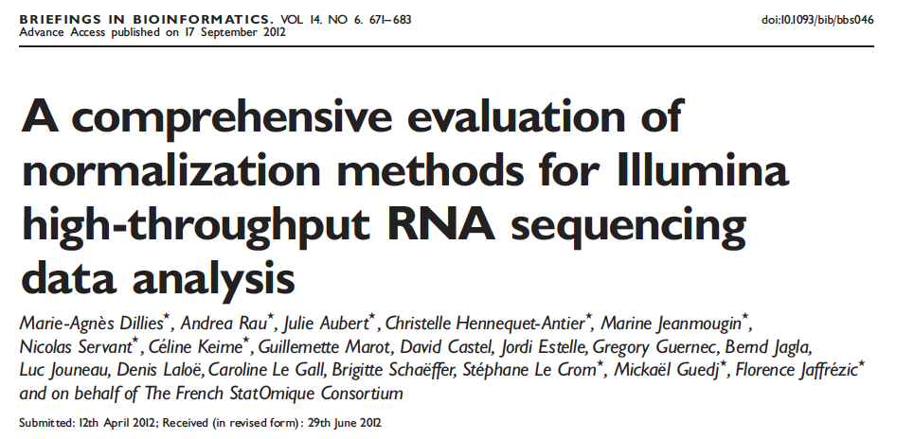
Normalization
Compared 7 methods of normalization (including DESeq2 and TMM)
Differences are most apparent when there are large differences in library size between samples
Presence of few high-count genes and large number of 0 counts affect normalization
DESeq2 and TMM (edgeR) had low false positive rate and high power
Notes:
Script:
-Paper evaluating different normalization methods. There are other papers by other authors.
-In this paper, 7 methods of normalization with different datasets (mRNA and miRNA)
-Library size, presence of few high count and large number of 0 counts affects normalization
-DESeq2 and TMM “best” methods
Information:
Dillies et al. Briefings in Bioinformatics, Vol. 14 (6): 671–683 (2013)
https://exrna.org/normalization-of-small-rna-seq-data-from-extracellular-rna-samples/
Authors suggest DESeq2 and TMM as methods of choice based on different library sizes and composition
Dillies et al. published another comparison of normalization methods for RNAseq data in about the same time frame. Most of the datasets used were long RNAseq data, but a murine microRNA dataset was included. The seven methods compared in this study included TC (total counts), UQ (Upper Quartile), Median, DEseq, TMM, quantile and RPKM. TC, UQ and median are scaling approaches that are quite similar, involving the calculation of a scaling factor based on either the ratio of total counts (TC), upper quartile of counts (UQ) or median of counts. The authors assessed these normalization methods on real as well as simulated data. In their analysis, it is apparent that when boxplots of counts before and after normalization are assessed, the differences are most apparent in conditions where there are large differences in library size between samples. These differences do not improve after TC and RPKM normalization of the microRNA-seq data. Other features of microRNA-seq data that influence the results of the normalization according to the authors are the presence of high-count genes and a large number of 0 counts. Quantile normalization increases the intra-condition variability in the murine miRNA data. Based on the results of differential expression in this study, it is apparent that the differences in the final results depend on the normalization method and not on the model chosen to assess for differential expression (DESeq or TSPM). In the simulated data, which contains high count genes and may resemble microRNA seq data more closely than the other datasets, only DESeq and TMM were successful in achieving a low false positive rate and high power. The authors conclude that DESeq and TMM are the methods of choice based on their ability to perform in the presence of different library sizes and composition.

Slide 16

Break: 5 min

Slide 17
DESeq2 and EdgeR
Programs for differential gene expression (DE) analysis
Utilizes negative binomial model to model distribution of each gene
Assumes that most genes are not DE
Extensive documentation and examples available online
Documentation: https://bioconductor.org/packages/release/bioc/manuals/DESeq2/man/DESeq2.pdf
https://www.bioconductor.org/packages/release/bioc/vignettes/edgeR/inst/doc/edgeRUsersGuide.pdf
Examples: https://bioconductor.org/packages/release/bioc/vignettes/DESeq2/inst/doc/DESeq2.html
https://www.ncbi.nlm.nih.gov/pmc/articles/PMC4937821/pdf/f1000research-5-18347.pdf
Notes:
https://www.thoughtco.com/negative-binomial-distribution-4091991
The negative binomial distribution is a probability distribution that is used with discrete random variables. This type of distribution concerns the number of trials that must occur in order to have a predetermined number of successes. As we will see, the negative binomial distribution is related to the binomial distribution. In addition, this distribution generalizes the geometric distribution.

Slide 18
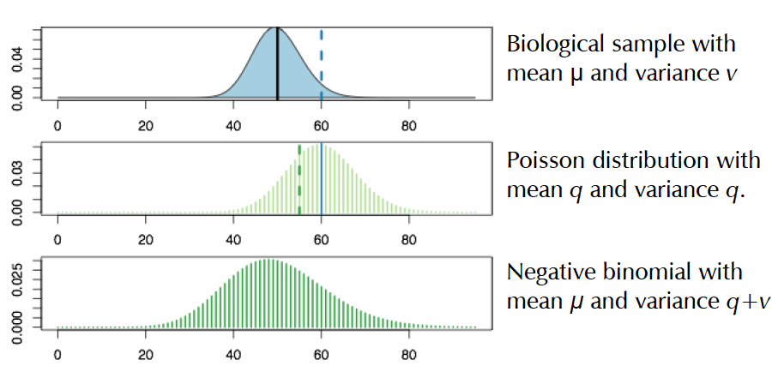
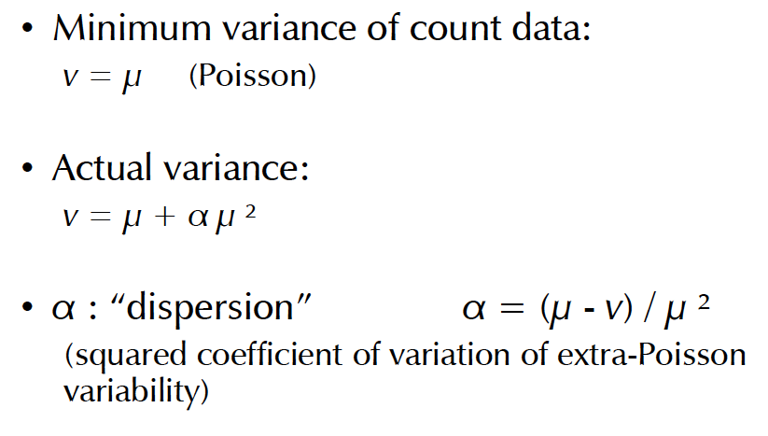
Negative binomial distribution
Poisson
Negative binomial
Notes:
Script:
-Counts do not follow a normal distribution
-Poisson which assumes mean is equal to variance
-Negative binomial which takes into account dispersion
Figure and information:
https://www.bioconductor.org/help/course-materials/2014/CSAMA2014/2_Tuesday/lectures/DESeq2-Anders.pdf
https://support.bioconductor.org/p/74572/
A distributional assumption is needed because we want to estimate the probability of extreme events (large fold change just appearing by chance) from limited replicates. The negative binomial (a.k.a. Gamma-Poisson) is a good choice for RNA-seq experiments because
the observed data at gene level is inherently counts or estimated counts of fragments for each feature and
the spread of values among biological replicates is more than given by a simpler, one parameter distribution, the Poisson; and it seems to be captured by the NB sufficiently well
http://bridgeslab.sph.umich.edu/posts/why-do-we-use-the-negative-binomial-distribution-for-rnaseq
First of all, since reads are count based, they can't be normally distributed (you can't have -3 counts, or 12.2 counts). Two distributions for count based data are poisson (which presumes the variance and mean [ie expression in our case] are equal) or negative binomial (which does not). This is especially a problem when the number of biological replicates are low because it is hard to accurately model variance of count based data if you are looking at only that gene and making the assumptions of normally distributed continuous data (ie a t-test). A good estimate of variance for each gene is essential to determine whether the changes are due to chance.
Most RNAseq tools allow for the global variance (ie for a gene in 'general') to be estimated for a certain read density. This generates a more accurate estimate of the variance than looking at each individual gene's (potentially small n) distribution because you can make some assumptions in general about how low expressing and high expressing genes vary.
This variance parameter is then used to model the NB distribution for each gene (because it allows for expression and variance to be unlinked) and therefore to more accurately estimate the error term. As the number of samples increases, the local (gene-specific) variance can be better estimated (but the expression will generally follow a skewed, stochastic and non-normal distribution).

Slide 19
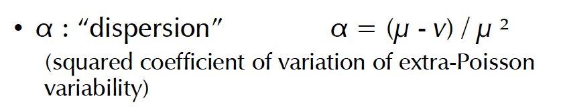
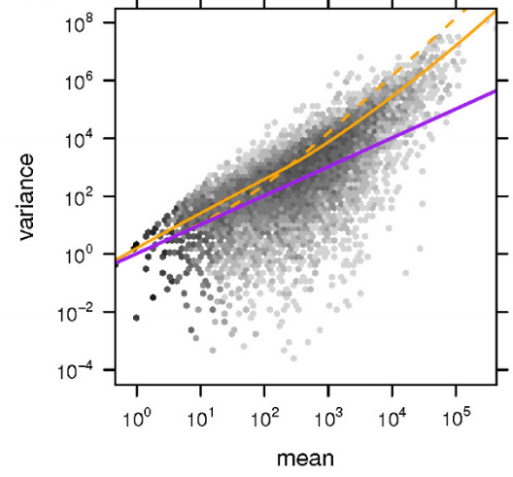
Dispersion
- - : estimate using edgeR
: fit to real RNA- Seq data
: Poisson variance for each mean
Dispersion is a measure of the spread or variability in the data
Biological Data is often ‘overdispersed’. With increasing mean the variance grows disproportionally
Negative binomial model can account for this overdispersion
Notes:
Figures and information:
https://hbctraining.github.io/DGE_workshop/lessons/04_DGE_DESeq2_analysis.html
Simon Anders and Wolfgang Huber 2010
https://genomebiology.biomedcentral.com/articles/10.1186/gb-2010-11-10-r106
Dependence of the variance on the mean for condition A in the fly RNA-Seq data. (a) The scatter plot shows the common-scale sample variances (Equation (7)) plotted against the common-scale means (Equation (6)). The orange line is the fit w(q). The purple lines show the variance implied by the Poisson distribution for each of the two samples, that is, 𝑠ˆ𝑗𝑞ˆ𝑖,𝐴s^jq^i,A. The dashed orange line is the variance estimate used by edgeR.
What is dispersion?
Dispersion is a measure of spread or variability in the data. Variance, standard deviation, IQR, among other measures, can all be used to measure dispersion. However, DESeq2 uses a specific measure of dispersion (α) related to the mean (μ) and variance of the data: Var = μ + α*μ^2. For genes with moderate to high count values, the square root of dispersion will be equal to the coefficient of variation (Var / μ). So 0.01 dispersion means 10% variation around the mean expected across biological replicates.
What does the DESeq2 dispersion represent?
The DESeq2 dispersion estimates are inversely related to the mean and directly related to variance. Based on this relationship, the dispersion is higher for small mean counts and lower for large mean counts. The dispersion estimates for genes with the same mean will differ only based on their variance. Therefore, the dispersion estimates reflect the variance in gene expression for a given mean value.

Slide 20
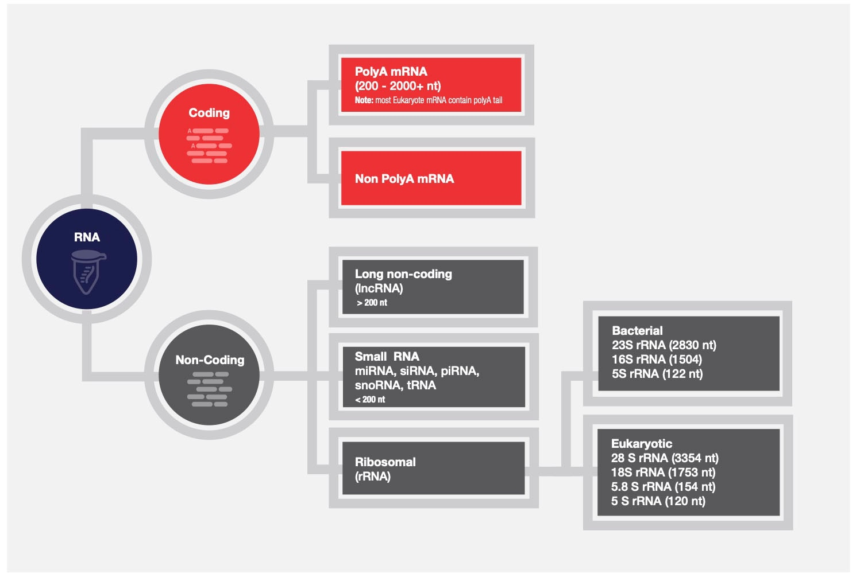
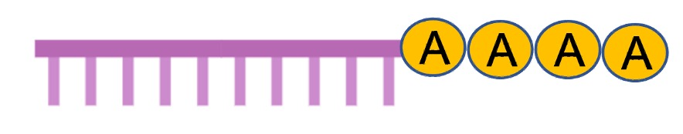
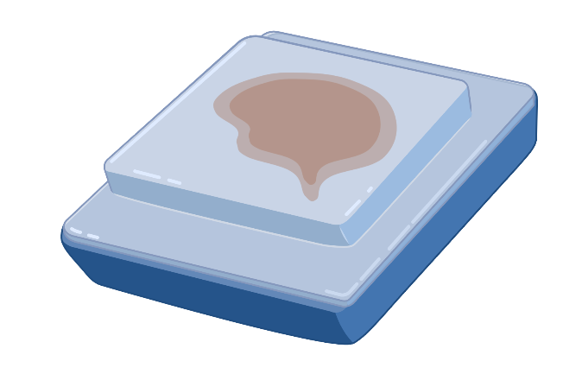

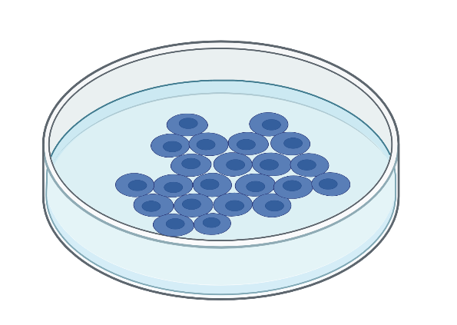

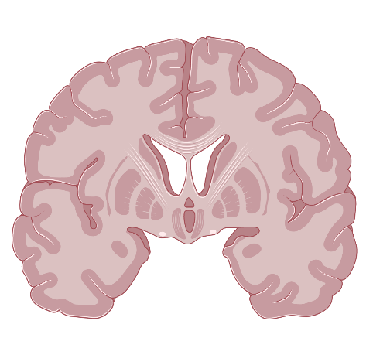
RNA-Seq
Notes:
Script: Small RNA seq analysis. Not many pipelines for miRNA-Seq analysis
Figure:
Biorender
https://www.thermofisher.com/us/en/home/life-science/dna-rna-purification-analysis/rna-extraction/rna-applications/ribosomal-rna-depletion.html
Information:
https://www.thermofisher.com/us/en/home/life-science/sequencing/sequencing-learning-center/next-generation-sequencing-information/ngs-basics/rna-sequencing-methods.html
Total RNA:
Whole transcriptome analysis
Coding and noncoding RNA
Potential inefficiencies and bias due to different sequencing lengths
Targeted RNA:
Sequencing specific transcripts of interest to analyze specific genes of interest
Degraded samples from FFPE
mRNA:
Poly(A) selection to sequence all messenger RNA for gene expression analysis
Identify novel and known content
Small RNA:
- Isolation of small RNA
miRNA, piRNA, tRNA etc.
Gene regulation

Slide 21
DESeq2 and edgeR: Long RNA-Seq
http://bioconductor.org/packages/release/bioc/vignettes/DESeq2/inst/doc/DESeq2.html
https://lashlock.github.io/compbio/R_presentation.html
https://genviz.org/module-04-expression/0004/02/01/DifferentialExpression/
http://www.nathalievialaneix.eu/doc/html/solution_edgeR-tomato-withcode.html
https://web.stanford.edu/class/bios221/labs/rnaseq/lab_4_rnaseq.html
https://www.bioconductor.org/packages/release/bioc/vignettes/edgeR/inst/doc/edgeRUsersGuide.pdf
Notes:
Tutorials with practice datasets and code

Slide 22
Extracellular Small RNA
Small RNAs:
miRNA: 22nt, RNA interference
piRNA: 26-31nt, Piwi interacting RNAi
tRNA: 15-50nt, transfer RNA
30-10,000 nm
Notes:
Script:
-Extracellular vesicles are highly heterogeneous populations with different types of RNA cargo within them and in different amounts and proportions
-Small RNAs-
miRNA-non coding RNA which plays a role in RNA silencing and post-transcriptional regulation of gene expression
piRNA-largest class, epigenetic modifications
tRNA-link between mRNA and AA
Figure and information:
O’ Brien et al, 2020. Nat Rev Mol Biol, Vol 21, pages585–606 (2020)
Front. Genet., 26 April 2019 | https://doi.org/10.3389/fgene.2019.00364
Biochemical Journal 474(10):1603-1618
Molecular mechanisms of Dicer: Endonuclease and enzymatic activity Biochemical Journal 474(10):1603-1618
A microRNA (abbreviated miRNA) is a small single-stranded non-coding RNA molecule (containing about 22 nucleotides) found in plants, animals and some viruses, that functions in RNA silencing and post-transcriptional regulation of gene expression.^{[1]} miRNAs function via base-pairing with complementary sequences within mRNA molecules.^{[2]} As a result, these mRNA molecules are silenced, by one or more of the following processes: (1) cleavage of the mRNA strand into two pieces, (2) destabilization of the mRNA through shortening of its poly(A) tail, and (3) less efficient translation of the mRNA into proteins by ribosomes.^{[2][3]}
Piwi-interacting RNA (piRNA) is the largest class of small non-coding RNA molecules expressed in animal cells.^{[1][2][3]} piRNAs form RNA-protein complexes through interactions with piwi-subfamily Argonaute proteins. These piRNA complexes are mostly involved in the epigenetic and post-transcriptional silencing of transposable elements and other spurious or repeat-derived transcripts, but can also be involved in the regulation of other genetic elements in germ line cells.^{[4][5][6]}
Transfer RNA (abbreviated tRNA and formerly referred to as sRNA, for soluble RNA^{[1]}) is an adaptor molecule composed of RNA, typically 76 to 90 nucleotides in length (in eukaryotes),^{[2]} that serves as the physical link between the mRNA and the amino acid sequence of proteins. Transfer RNA (tRNA) does this by carrying an amino acid to the protein synthesizing machinery of a cell called the ribosome.

Slide 23
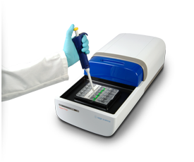
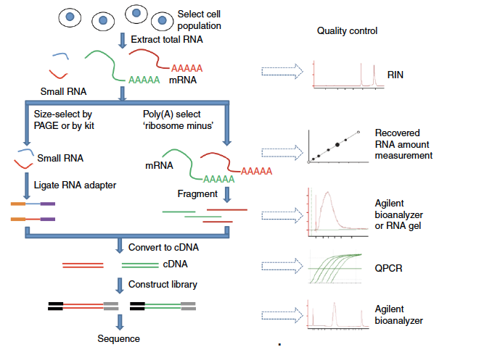
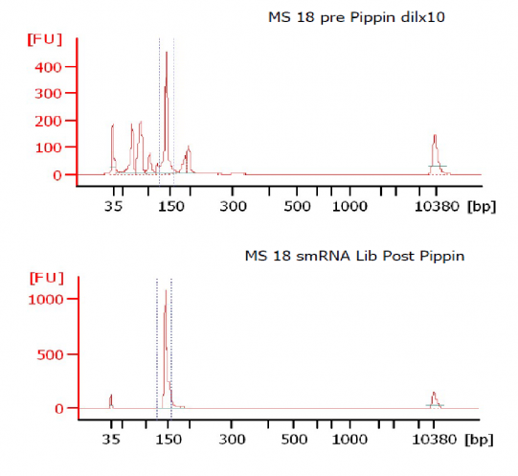
Small vs. Long RNA Lib Prep
Pippin
Bioanalyzer: QC
Notes:
Script:
Size selection for small RNAs
Figures and information:
https://sagescience.com/blog/at-iowa-core-lab-pippin-sizing-is-essential-for-microrna-studies/
https://sagescience.com/products/pippin-prep/
https://chagall.med.cornell.edu/RNASEQcourse/Intro2RNAseq.pdf

Slide 24
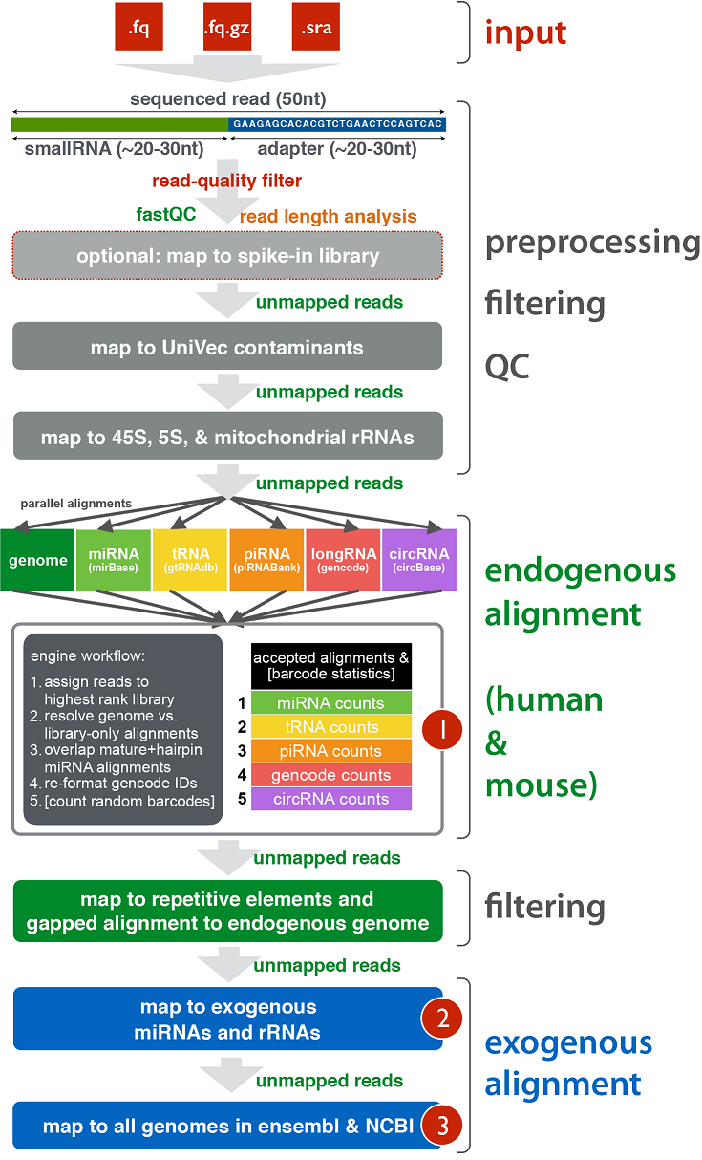
Genboree: exceRpt Small RNA Pipeline
miRNA read counts .txt file
https://www.genboree.org/site/
Notes:
https://genboree.org/theCommons/projects/exrna-tools-may2014/wiki/Small_RNA-seq_Pipeline
Script: Show Genboree GUI

Slide 25
miRNA-Seq Analysis
Non-normal distribution of expression of different small RNAs, particularly miRNAs
Few miRNAs account for large fraction of total reads while majority contribute a small percentage (large number of 0 reads)
Extracellular RNA sample input amounts are extremely limited
Increased potential for sampling error and experimental bias
Notes:
Information:
Dillies et al. Briefings in Bioinformatics, Vol. 14 (6): 671–683 (2013)
https://exrna.org/normalization-of-small-rna-seq-data-from-extracellular-rna-samples/
RNA-Seq experiments: Sources of systematic variation include library size, transcript length, and GC content (Dillies et al. 2012)

Slide 26
DESeq2 and TMM for miRNA-Seq Analysis
“TMM (weighted trimmed mean of log expression) determines scaling factor calculated after double trimming values at the two extremes based on log-intensity ratios (M-values) and log-intensity averages (A-values)” (Dillies et al 2012)
Variability in estimated RNA content may be more pronounced in miRNA-Seq datasets using this method (Garmire et al 2012)
“DESeq2 calculates a scaling factor for each sample in the dataset by computing the median of the ratios of each gene in one sample over the geometric mean of that gene across all samples. The same scaling factor is then applied to the read counts for all of the genes in that sample” (Dillies et al 2012)
Statistical test does not assume comparable distribution of read counts
Notes:
Information:
Dillies et al. Briefings in Bioinformatics, Vol. 14 (6): 671–683 (2013)
Garmire et al. RNA 18(6): 1279–1288 (2012)
https://exrna.org/normalization-of-small-rna-seq-data-from-extracellular-rna-samples/
Trimmed mean of M-values (TMM) normalization is used to calculate normalization factors in order to correct for different library sizes and to reduce RNA composition effect, which arises when a small number of genes are very highly expressed in one experiment condition but not in the other.
https://chipster.csc.fi/manual/ngs-dea-edger-RNA.html
A trimmed mean is the average after removing the upper and lower x% of the data.
https://www.biostars.org/p/269870/
The TMM factor is computed for each lane, with one lane being considered as a reference sample and the others as test samples. For each test sample, TMM is computed as the weighted mean of log ratios between this test and the reference, after exclusion of the most expressed genes and the genes with the largest log ratios.
DESeq2 was developed to find differentially expressed genes between two conditions for RNA-seq data with small sample size and overdispersion using a model based on a negative binomial distribution and local regression to estimate the relationship between the mean and variance of each gene

Slide 27
DESeq2 and TMM for miRNA-Seq Analysis
Both methods assume most genes are not DE, which may not be true in miRNA-Seq datasets
Both methods propose scaling factor based on a mean (TMM) or median (DESeq2) ratio
TMM scaling factor applies to library sizes
DESeq2 scaling factor applies to read counts
Dillies et al. Briefings in Bioinformatics, Vol. 14 (6): 671–683 (2013)

Slide 28
Example miRNA-Seq Dataset: Serum exRNA
Extracellular small RNA (exRNA): Extraction method matters
Srinivasan et al. Cell 2019 Apr 4;177(2):446-462
Notes:
Script:
Reinforce from previous lecture that RNA extraction method matters, especially for extracellular RNA
Information:
Srinivasan et al. Cell 2019 Apr 4;177(2):446-462

Slide 29
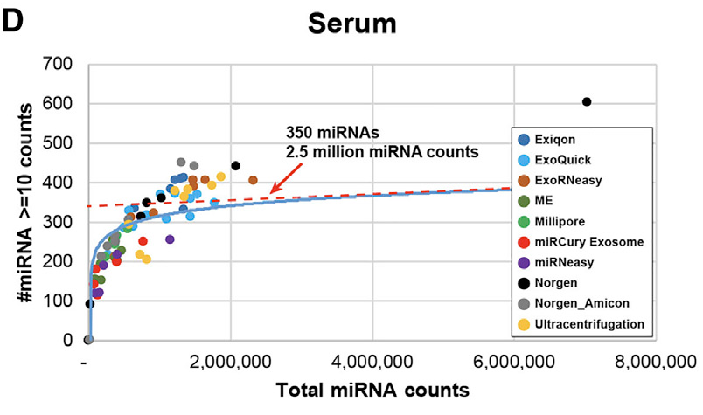
Example miRNA-Seq Dataset: Serum exRNA
Serum extracellular RNA
Two methods of extraction from female pooled serum samples
ExoRneasy: 4 samples
Norgen: 3 samples
Raw count data after processing on Genboree exceRpt small RNA pipeline
Srinivasan et al. Cell 2019 Apr 4;177(2):446-462
Notes:
Script:
-Complexity- unique miRNAs with 10 or more raw counts
-Complexity plot- against total miRNA counts
-Cpm cutoff for filtering data
-Excel file
Information and figure:
Srinivasan et al. Cell 2019 Apr 4;177(2):446-462
https://rdrr.io/bioc/DESeq2/man/rlog.html
http://bioconductor.org/packages/devel/bioc/vignettes/DESeq2/inst/doc/DESeq2.html#why-un-normalized-counts

Slide 30

Break: 10 minutes

Slide 31
Exercise: miRNA-Seq Differential Expression Analysis using DESeq2 and edgeR-TMM

Slide 32
Normalization
Normalization method | Description | Accounted factors | Recommendations for use
CPM (counts per million) | Counts scaled by total number of reads | Sequencing depth | Gene count comparisons between replicates of the same sample group; NOT for within sample comparisons or DE analysis
DESeq2’s median of ratios | Counts divided by sample-specific size factors determined by median ratio of gene counts relative to geometric mean per gene | Sequencing depth and RNA composition | Gene count comparisons between samples and for DE analysis; NOT for within sample comparisons
EdgeR’s Trimmed Mean of M values (TMM) | Uses a weighted trimmed mean of the log expression ratios between samples | Sequencing depth, RNA composition, and gene length | Gene count comparisons between and within samples and for DE analysis
Notes:
Information:
https://pubmed.ncbi.nlm.nih.gov/22988256/
https://www.biostars.org/p/284775/
https://hbctraining.github.io/DGE_workshop/lessons/02_DGE_count_normalization.html
DESeq: This normalization method [14] is included in the DESeq Bioconductor package (version 1.6.0) [14] and is based on the hypothesis that most genes are not DE. A DESeq scaling factor for a given lane is computed as the median of the ratio, for each gene, of its read count over its geometric mean across all lanes. The underlying idea is that non-DE genes should have similar read counts across samples, leading to a ratio of 1. Assuming most genes are not DE, the median of this ratio for the lane provides an estimate of the correction factor that should be applied to all read counts of this lane to fulfill the hypothesis. By calling the estimateSizeFactors() and sizeFactors() functions in the DESeq Bioconductor package, this factor is computed for each lane, and raw read counts are divided by the factor associated with their sequencing lane.
Trimmed Mean of M-values (TMM): This normalization method [17] is implemented in the edgeR Bioconductor package (version 2.4.0). It is also based on the hypothesis that most genes are not DE. The TMM factor is computed for each lane, with one lane being considered as a reference sample and the others as test samples. For each test sample, TMM is computed as the weighted mean of log ratios between this test and the reference, after exclusion of the most expressed genes and the genes with the largest log ratios. According to the hypothesis of low DE, this TMM should be close to 1. If it is not, its value provides an estimate of the correction factor that must be applied to the library sizes (and not the raw counts) in order to fulfill the hypothesis. The calcNormFactors() function in the edgeR Bioconductor package provides these scaling factors. To obtain normalized read counts, these normalization factors are re-scaled by the mean of the normalized library sizes. Normalized read counts are obtained by dividing raw read counts by these re-scaled normalization factors.
Quantile (Q): First proposed in the context of microarray data, this normalization method consists in matching distributions of gene counts across lanes [22, 23]. It is implemented in the Bioconductor package limma [31] by calling the normalizeQuantiles() function.

Slide 33
DESeq2: miRNA-Seq Exercise
Input data: Raw, unfiltered read counts
Filtering:
Pre-filtering not necessary but can be done to reduce memory size of dds object, increase speed of transformation and testing functions
Independent filtering (default) results function automatically performs independent filtering based on the mean of normalized counts for each gene, optimizing the number of genes which will have an adjusted p value below a given FDR cutoff, alpha
Weakly expressed genes that have no chance of DE, since low read counts suffer from high noise that any biological effect is drowned out by uncertainties from read counting
Results:
Results tables are generated using the function results, which extracts a results table with log2 fold changes, p values and adjusted p values.
rlog:
Transforms the count data to the log2 scale in a way which minimizes differences between samples for rows with small counts, and which normalizes with respect to library size.
PCA plot:
Visualize the overall effect of experimental covariates and batch effects
Distance matrix:
A heatmap of this distance matrix gives us an overview over similarities and dissimilarities between samples
DE analysis:
Wald test
Heatmap to visualize DE miRNAs
Notes:
Information:
https://rdrr.io/bioc/DESeq2/man/rlog.html
http://bioconductor.org/packages/devel/bioc/vignettes/DESeq2/inst/doc/DESeq2.html#pre-filtering
https://bioc.ism.ac.jp/packages/2.14/bioc/vignettes/DESeq2/inst/doc/beginner.pdf
https://rdrr.io/bioc/DESeq2/man/rlog.html
http://bioconductor.org/packages/devel/bioc/vignettes/DESeq2/inst/doc/DESeq2.html#why-un-normalized-counts
https://rdrr.io/bioc/DESeq2/man/rlog.html
http://bioconductor.org/packages/devel/bioc/vignettes/DESeq2/inst/doc/DESeq2.html#pre-filtering
https://bioc.ism.ac.jp/packages/2.14/bioc/vignettes/DESeq2/inst/doc/beginner.pdf
The results function of the DESeq2 package performs independent filtering by default using the mean of normalized counts as a filter statistic. A threshold on the filter statistic is found which optimizes the number of adjusted p values lower than a significance level alpha.
estimatesizeFactors: This function estimates the size factors using the "median ratio method”. The size factor is the median ratio of the sample over a pseudosample: for each gene, the geometric mean of all samples.

Slide 34
EdgeR- TMM: miRNA-Seq Exercise
Input data: Raw, unfiltered read counts
Filtering:
EdgeR has options to filter data by group
Filtering conducted using cpm cutoff
Normalization:
TMM
Estimate dispersion:
For data with single factor
Dispersion=biological coefficent of variation (BCV) squared
Visualization of normalized and unnormalized data
PCA plot
DE analysis:
Exact test, similar to Fisher’s exact test
Heatmap to visualize DE miRNAs
Notes:
https://chipster.csc.fi/manual/ngs-dea-edger-RNA.html
https://www.bioconductor.org/packages/release/bioc/vignettes/edgeR/inst/doc/edgeRUsersGuide.pdf
Dispersion means biological coeffient of variation (BCV) squared. E.g. if genes expression typically differs from replicate to replicate by 20% its BCV is 0.2, and its dispersion is 0.04. EdgeR estimates dispersion from replicates using the quantile-adjusted conditional maximum likelyhood method (qCML). Common dispersion calculates a common dispersion value for all genes, while the tagwise method calculates gene-specific dispersions. It uses an empirical Bayes strategy to squeeze the original gene-wise dispersions towards the global, abundance-dependent trend.

Slide 35
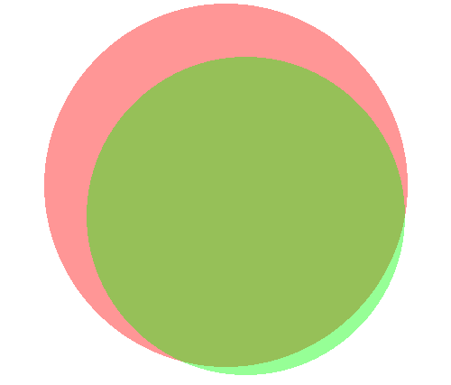
Overlap in DE miRNAs using DESeq2 and TMM
DESeq2
21
edgeR-TMM
59
2
Notes:
https://mikelove.wordpress.com/2016/09/28/deseq2-or-edger/
What’s different then?
The major differences between the two methods are in some of the defaults. DESeq2 by default does a couple things (which can all optionally be turned off): it finds an optimal value at which to filter low count genes, flags genes with large outlier counts or removes these outlier values when there are sufficient samples per group (n>6), excludes from the estimation of the dispersion prior and dispersion moderation those genes with very high within-group variance, and moderates log fold changes which have small statistical support (e.g. from low count genes).
edgeR offers similar functionality, for example, it offers a robust dispersion estimation function, estimateGLMRobustDisp, which reduces the effect of individual outlier counts, and a robust argument to estimateDisp so that hyperparameters are not overly affected by genes with very high within-group variance. And the default steps in the edgeR User Guide for filtering low counts genes both increases power by reducing multiple testing burden and removes genes with uninformative log fold changes.

Slide 36
Thank You!
Assistant Prof. Alon Goren
TAs:
Pratibha Jagannatha
Arya Massarat
Eric Kofman
Hannah Mummey

